Slide 1
Day 6 of 100dayscodechallenge Problem Statement: Java program that randomly picks an English alphabet (A-Z) and keeps asking the user to guess the alphabet until he/she has got it right. Sample Input: A Sample output: You guessed right-> You gave: A and output is: A

Slide 2
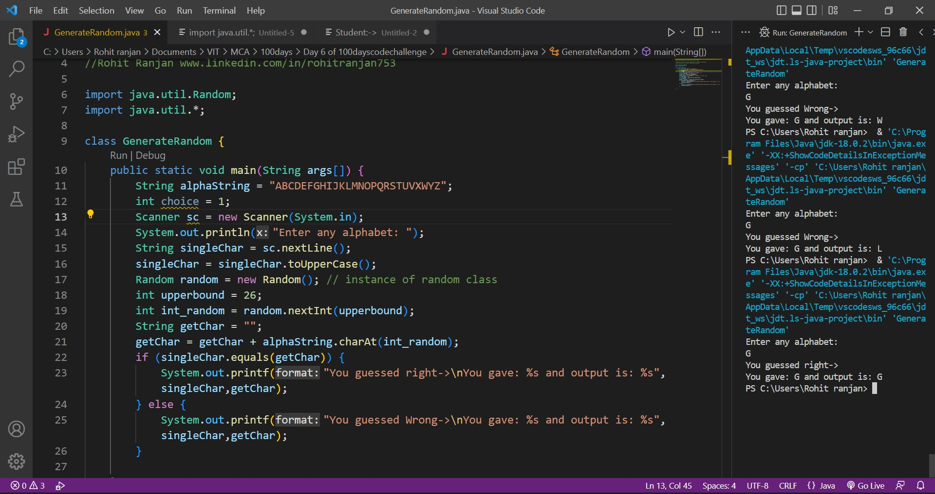
Solutions:

Slide 3
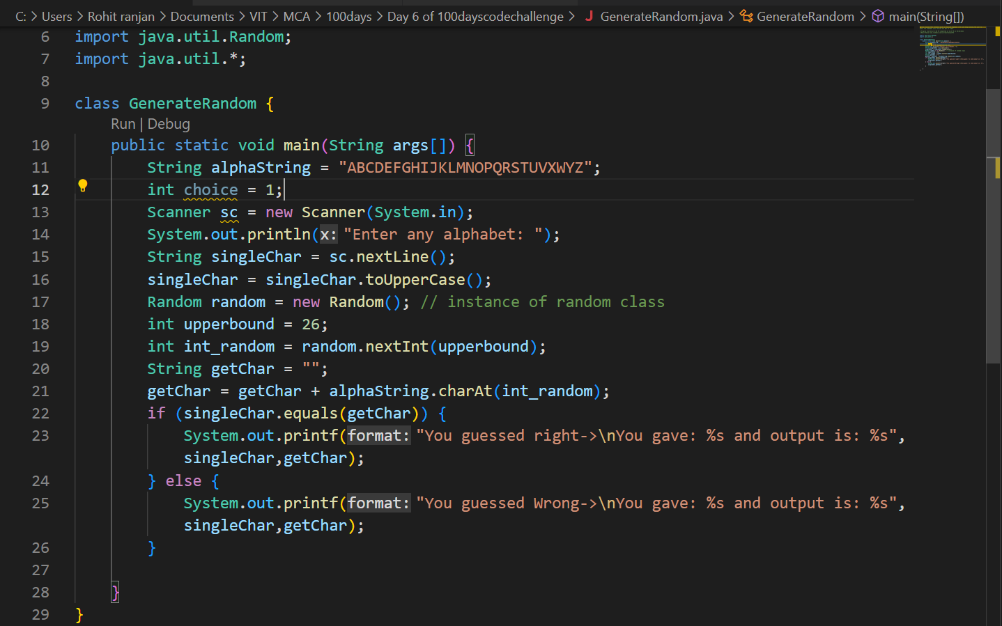
Explanation:
First we are initializing a string alphaString as “ABCDEFGHIJKLMNOPQRSTUVWXYZ”.
Then we are taking input from user and converting it to upper case.
After conversion to upper case we are creating an instance of Random class as “random” and in random.nextInt(upperbound) where upperbound value is 26 so that it will generate random numbers from 0 to 25.
After getting random alphabet we are comparing with the character entered by user.
If they are same then we are printing success otherwise failure.

